Slide 1
Project 2: Inflation News Market Influence & Stock Prediction
done BY: Janet mushava

Slide 2
What effect (if any) has inflation news had on the stock market and has this news influenced investor’s trading decisions?
What is inflation and why is it such a relevant market indicator?
Inflation is the rise in the price of goods and services which results in the decline of purchasing power of a given currency over time.
Inflation is a relevant market indicator because a decrease in purchasing power impacts the general cost of living for the common public which ultimately leads to a deceleration in economic growth.

Slide 3

What are the main factors that contribute to a rise in inflation?
Reduction in interest rates which incentivizes low-cost borrowing
Increase in money supply
Increase in oil prices which is closely linked to economic activity because oil is vital for producing and transporting goods
Increase in cost of imported goods which leads to an increase in domestic demand
Increase in wages which results in an increase of disposable income

Slide 4
What are investor market sentiments when inflation rises?
Investors often turn to investments like gold and gold stocks because gold is considered to be a safe haven during periods of economic instability.
Investors turn to the utilities sector because we all still need electricity, heat, gas, etc. regardless of the inflationary environment.
Investors turn to the real estate sector because property prices and rental incomes tend to rise when inflation rises. Also, Real Estate Investment Trusts (REITs) are often a hedge against inflation.

Slide 5
Based on typical investor sentiments, conduct a performance analysis to see if rising inflation news affects the stock market
Based on typical investor sentiments, analyze:
SPY (Overall)
GLD (Commodity)
XLRE (Real Estate)
USO (Oil)

Slide 6
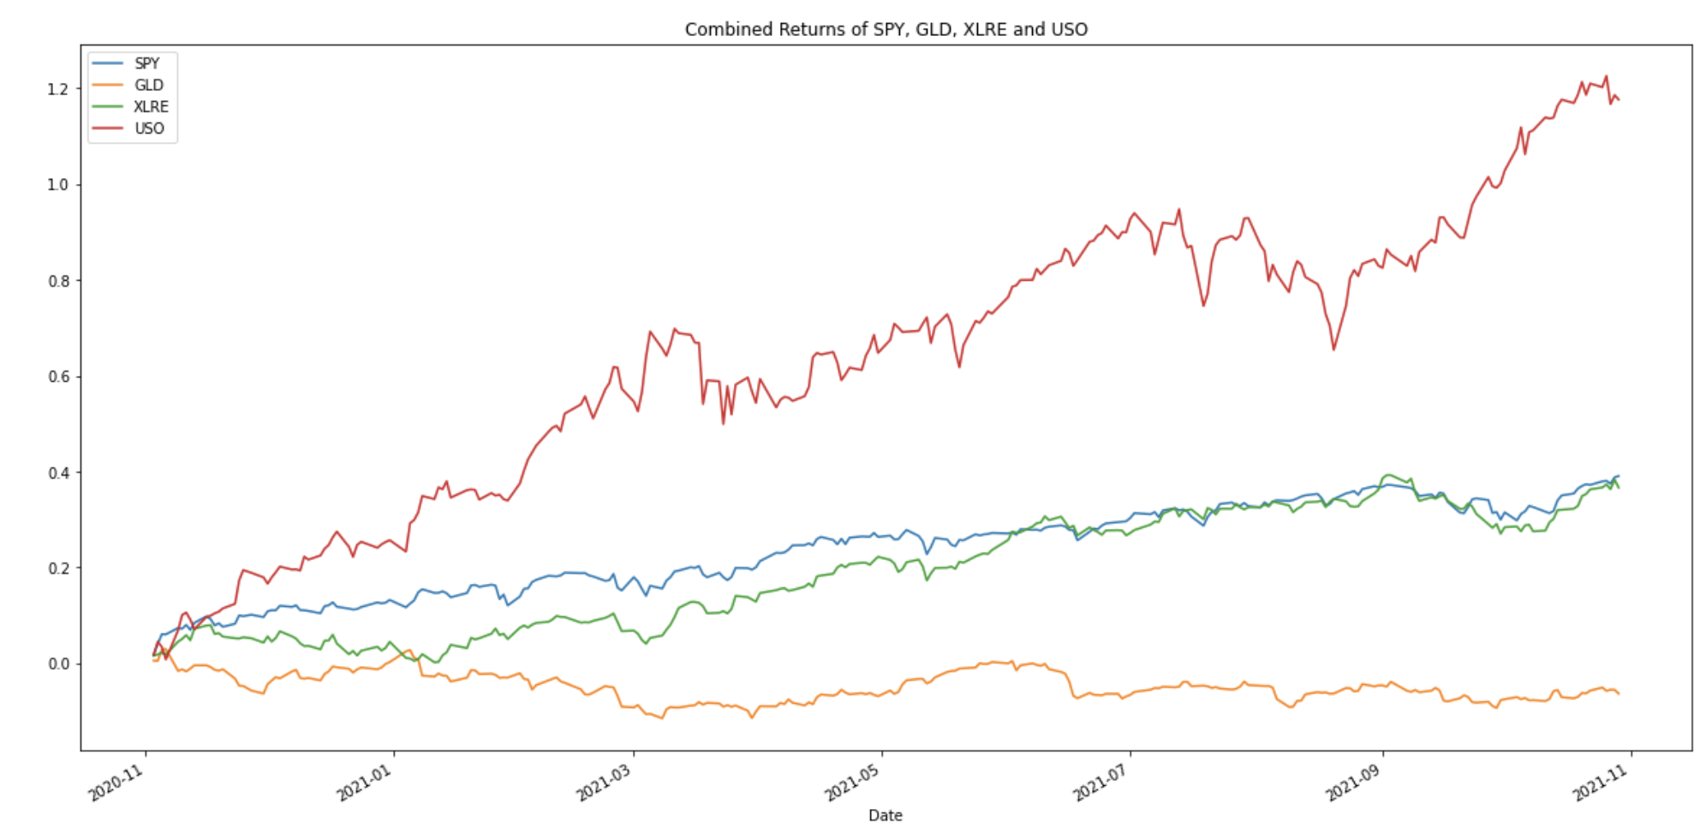
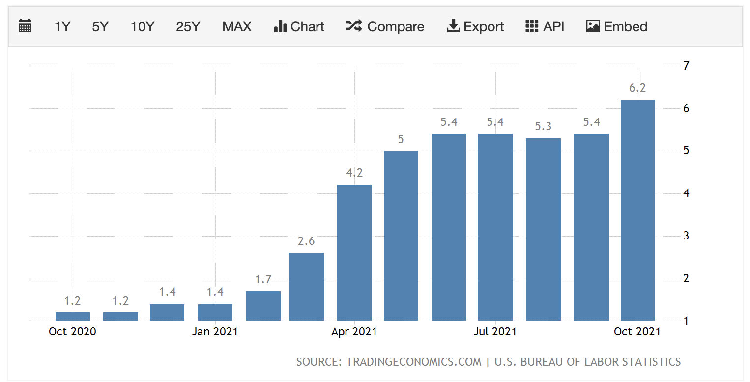
How did the market respond to changes in inflation?
Oil (USO) outperformed SPY, gold (GLD) and real estate (XLRE) stocks. This is not surprising because oil has a strong relationship with inflation. Oil is vital for producing and transporting goods therefore when inflation rises, so does the demand and price for goods and services.

Slide 7
Create a portfolio simulation based on performance analysis
Investor profile
Risk tolerance- high
Age- 30
Time horizon- 30 years
Asset type- various
Investment amount- $100,000
Because the investor is optimistic about the market, create a long-position algorithm

Slide 8
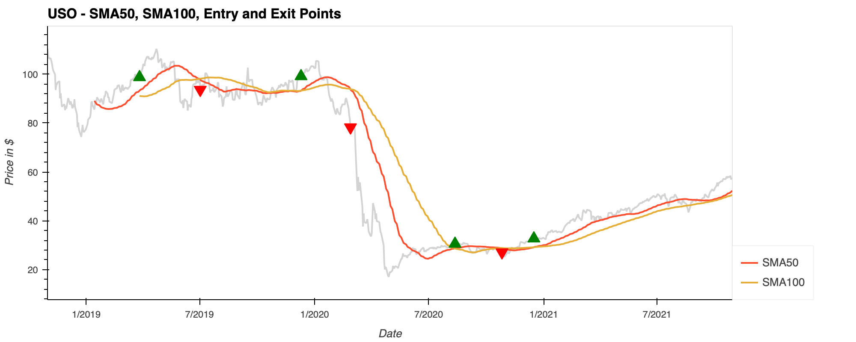
Long-Position Algorithm
A trade was entered when the “SMA50” value crossed above the “SMA100” value, and the trade was exited when the “SMA50” value crossed below the “SMA100” value.
The investor makes a profit using the “buy low, sell high” strategy.

Slide 9
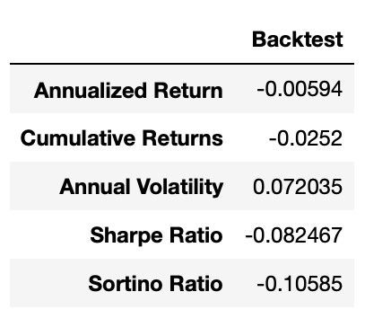
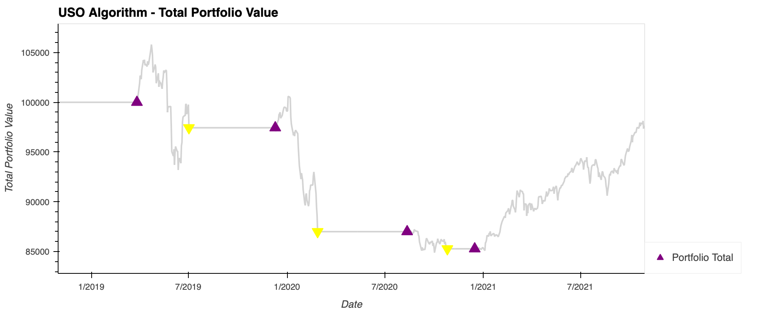
Backtesting the Long-Position Algorithm
The trading algorithm lost about $2,520 during the backtesting period. However, the loss was not consistent, the portfolio fluctuated and gained $5,800.
Because our investor is risk tolerant and has a long-term time horizon, I would still recommend this stock for their portfolio. If nothing else, this stock provides a good hedging strategy.
Annual volatility has a spread of about 7.20% surrounding the annualized return

Slide 10
Build an algorithmic trading bot to create trading signals for USO
1. Define Trading Strategy: When actual returns are greater than or equal to 0, buy stock long but if actual returns are less than 0, sell stock short.
2. Create trading signals for actual returns and strategy returns
3. Use the linear regression to predict the returns and analyze these returns

Slide 11
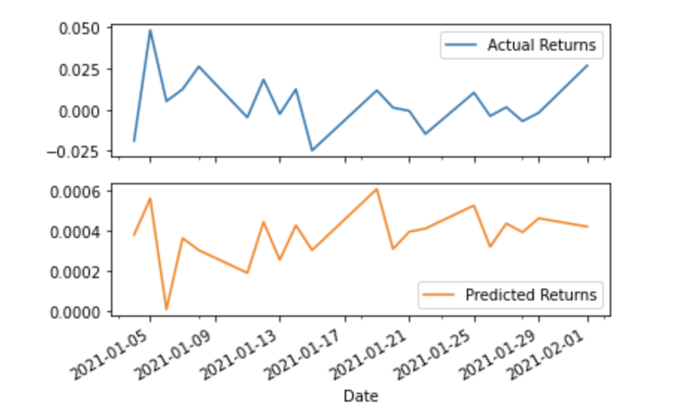
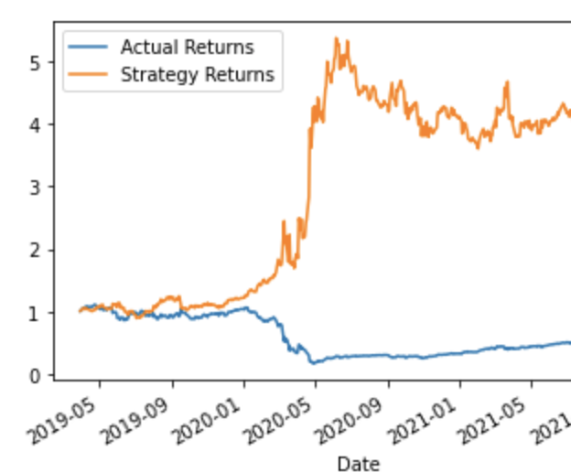
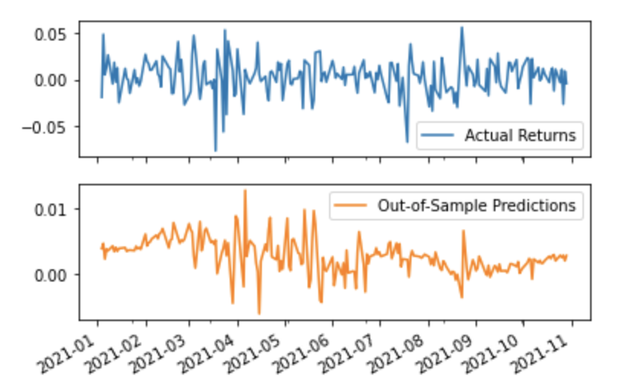
Actual Returns vs Predicted Returns Plot
Actual Returns vs Strategy Returns Plot
Actual Returns vs Out of Sample Predictions Plot
Data Visualization

Slide 12
Conclusion
Out of the three RMSE scores, the out-of-sample RMSE is the lowest. In this case, it is better to use out-of-sample data that the model hasn't seen before because it gives us a higher accuracy in our predictions. This makes sense if we factor in how inflation is constantly changing and unpredictable.
Based on the baseline performance and predicted returns, I would advise the investor to buy the stocks as the model shows the predicted results will be higher.
Overall, the investor is risk tolerant and this investment is a hedging strategy in times of high inflation, so the volatility and its performance are not deterrents.

Slide 13

Thank you for your time! Any Questions? ☺

